Slide 1

HOUSE PRICE EVALUATION
REGRATION MODEL

Slide 2
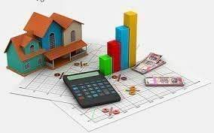
Introduction
Problem faced during buying house
Buyers are generally not aware of factors that influence the house price
Hence real estate agent are trusted with the communication between buyer and seller. This creates a middle man and increases the cost of house

Slide 3
Project Summary
The purpose of project is to create a machine learning app. It will try to guess the most accurate price based on certain specifications of your future home.
Information such as construction year, condition, bedroom, living space, etc ..

Slide 4

HOW IT WORKS

Slide 5
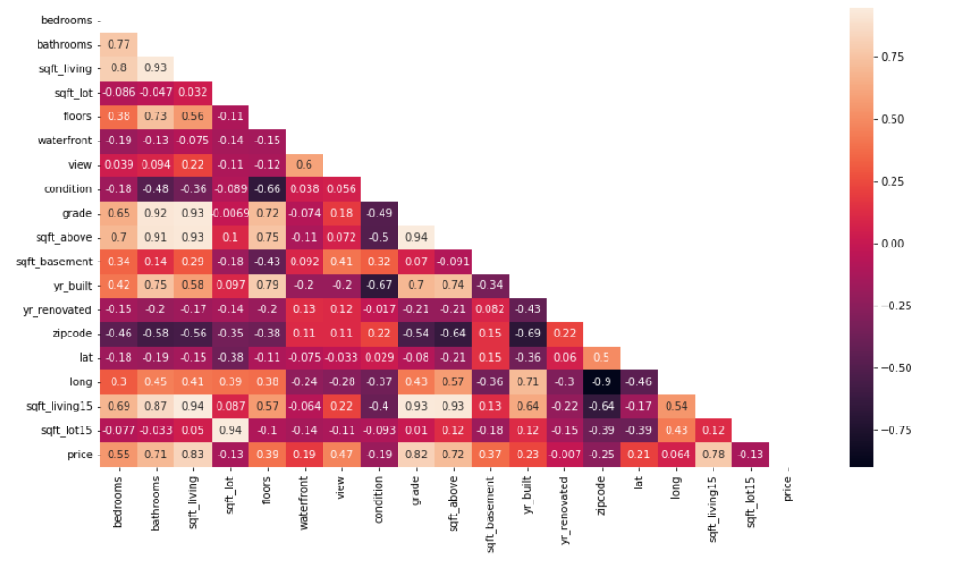
COLLECTING AND FORMATING DATA
FIRST STEP WAS TO COLLECT DATA FROM DIFFERENT SOURCES AND FORMATING DATA TO FORM OUR TRAINING SET
CHECK CORRELATION BETWEEN DATA COLUMNS TO FIND RELATION BETWEEN THEM

Slide 6
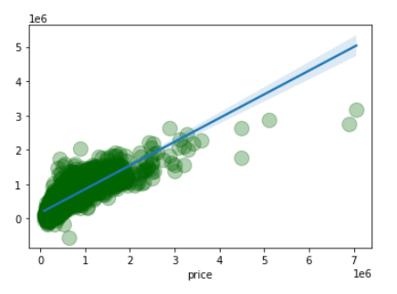
COLLECTING AND FORMATING DATA
THE MODEL WAS TRAINED USING MACHINE LEARNING ALGORITHM, WHICH IN THIS CASE LINEAR REGRESSION
GRAPH REPRESENTS PREDICTION VALUES FOR HOUSE PRICE
Regression score: 0.6858080545096988
Mean absolute error: 125639.5603781266
Mean squared error: 204111.17063352105

Slide 7


Slide 8
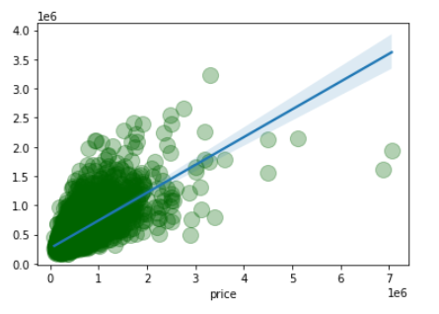
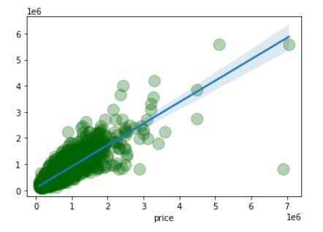
PRICE PREDICTION WITH TWO DIFFERENT REGRATION METHOS
KNeighborsRegressor
DecisionTreeRegressor
Regration score : 0.47739249340159906
Mean absolute error : 158925.15651234568
Mean squared error : 263243.14550393895
Regration score : 0.7506827493106801
Mean absolute error : 96770.8574845679
Mean squared error : 181821.57454370323

Slide 9


Thank You

